Slide 1



Rainfall Prediction
Maryam Khan(22F-3238)
M. Awais(22F-3233)
Mujahid(22F-3215)

Slide 2

CONTENTS
1. Abstract
2. Introduction
3. Dataset Exploration
4. Methodology
5. Results and Discussion
6. Deployment
7. Conclusion and Future Work
8. References

Slide 3



01
Abstract

Slide 4

Abstract
This project develops a machine learning model to predict rainfall in Pakistan, addressing needs in agriculture and disaster preparedness.
Using the weatherAUS.csv dataset, we conducted exploratory data analysis, preprocessed the data, and trained four models: Logistic Regression, Random Forest, XGBoost, and a Neural Network.
After hyperparameter tuning, XGBoost achieved the highest performance with an AUC of 0.89 and recall of 0.77.
The model was deployed as a web application on Hugging Face.
Limitations include the use of Australian data, suggesting future work with Pakistan-specific datasets.

Slide 5

02
Introduction

Slide 6






Introduction
Accurate forecasts support farming decisions and disaster mitigation.
Rainfall prediction is vital for Pakistan, where agriculture drives the economy and monsoons pose flood risks.
This project builds a rainfall prediction model using the weatherAUS.csv dataset from Kaggle, containing 145,460 rows and 23 features (e.g., temperature, humidity, rainfall) from Australian stations.
2
1
Objectives include:
•Analyze data characteristics through EDA.
•Preprocess and engineer features for modeling.
•Compare multiple machine learning models.
•Deploy the best model on Hugging Face.
3
5
4
Despite the mismatch, the dataset’s climate similarities with Pakistan make it a starting point.

Slide 7

03
Dataset Exploration

Slide 8



Dataset Exploration
Missing values were notable in Sunshine (48%) and Cloud9am (38%).
2
The dataset comprises 145,460 observations with 23 features, including MinTemp, MaxTemp, Rainfall, and RainTomorrow (Yes/No).
1
EDA revealed a 77% “No” and 23% “Yes” imbalance, skewed Rainfall and WindGustSpeed, and high correlation (0.96) between Pressure9am and Pressure3pm.
3

Slide 9

04
Methodology

Slide 10

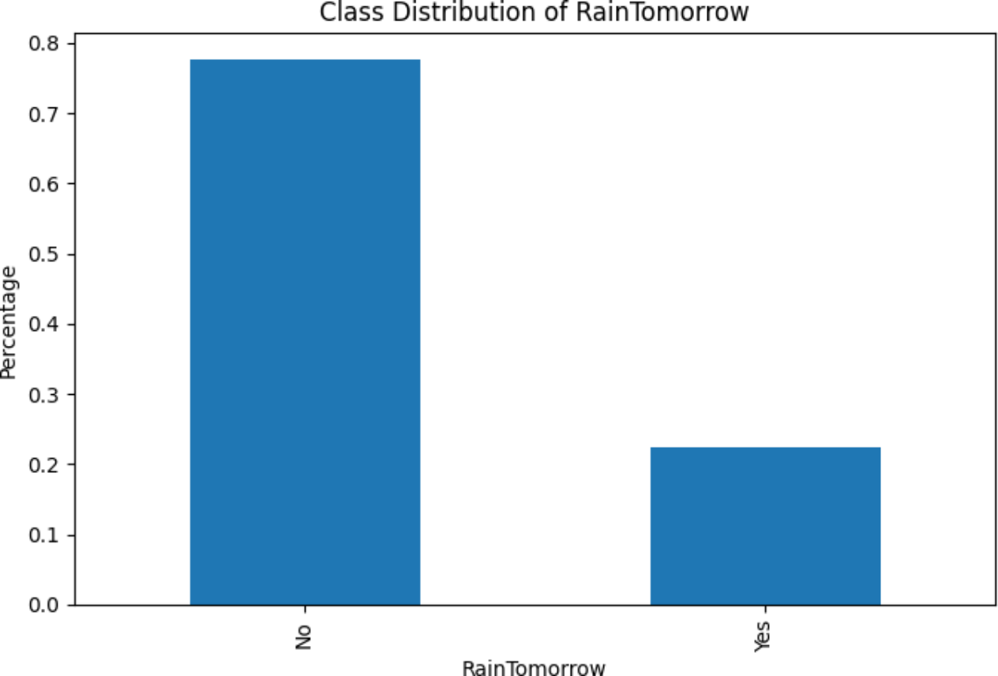
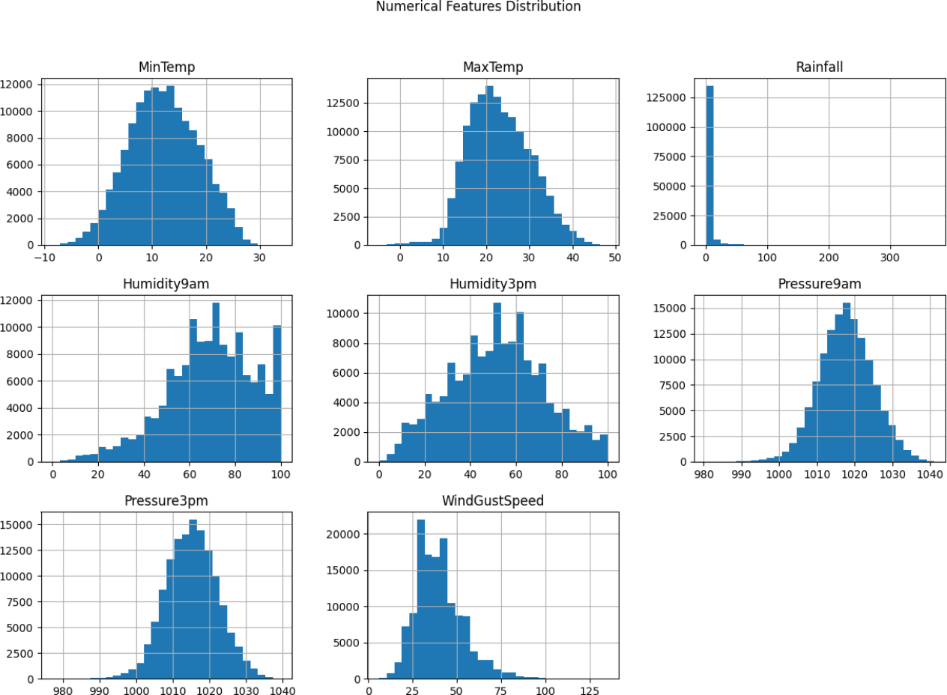






Preprocessing
Missing values were imputed with medians for numerical features (e.g., Sunshine) and “Missing” for categorical features (e.g., WindGustDir).
Outliers in Humidity9am and Humidity3pm were clipped to [1, 100].
Features were normalized with StandardScaler.
Engineered features included TempDiff and HumidityDiff.
Categorical variables were one-hot encoded, yielding 111 features.
Class imbalance was addressed with weights (balanced or scale_pos_weight).

Slide 11

Model Development
Four models were implemented:
•Logistic Regression: Baseline for interpretability.
•Random Forest: Ensemble for non-linear patterns.
•XGBoost: Gradient boosting for complex relationships.
•Neural Network: Three-layer model with dropout (0.2) and early stopping.

Slide 12

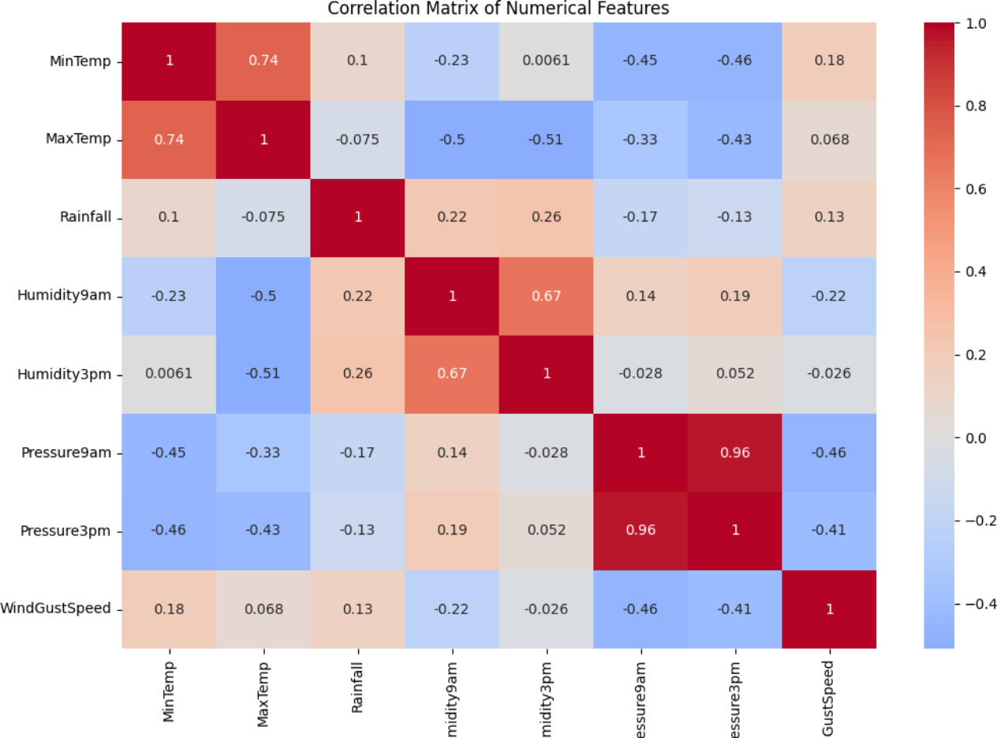
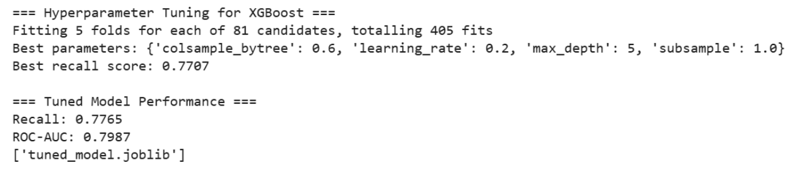
Hyperparameter Tuning
XGBoost was tuned with Grid Search (5-fold CV) on max_depth [3, 5, 7], learning_rate [0.01, 0.1, 0.3], subsample [0.7, 0.9], and colsample_by_tree [0.7, 0.9], optimizing recall.

Slide 13


Evaluation Metrics
Metrics included:
•Accuracy, Precision, Recall (prioritized for imbalance).
•F1 Score, ROC-AUC.
Confusion matrices and ROC curves were analyzed.

Slide 14

05
Results and Discussion

Slide 15

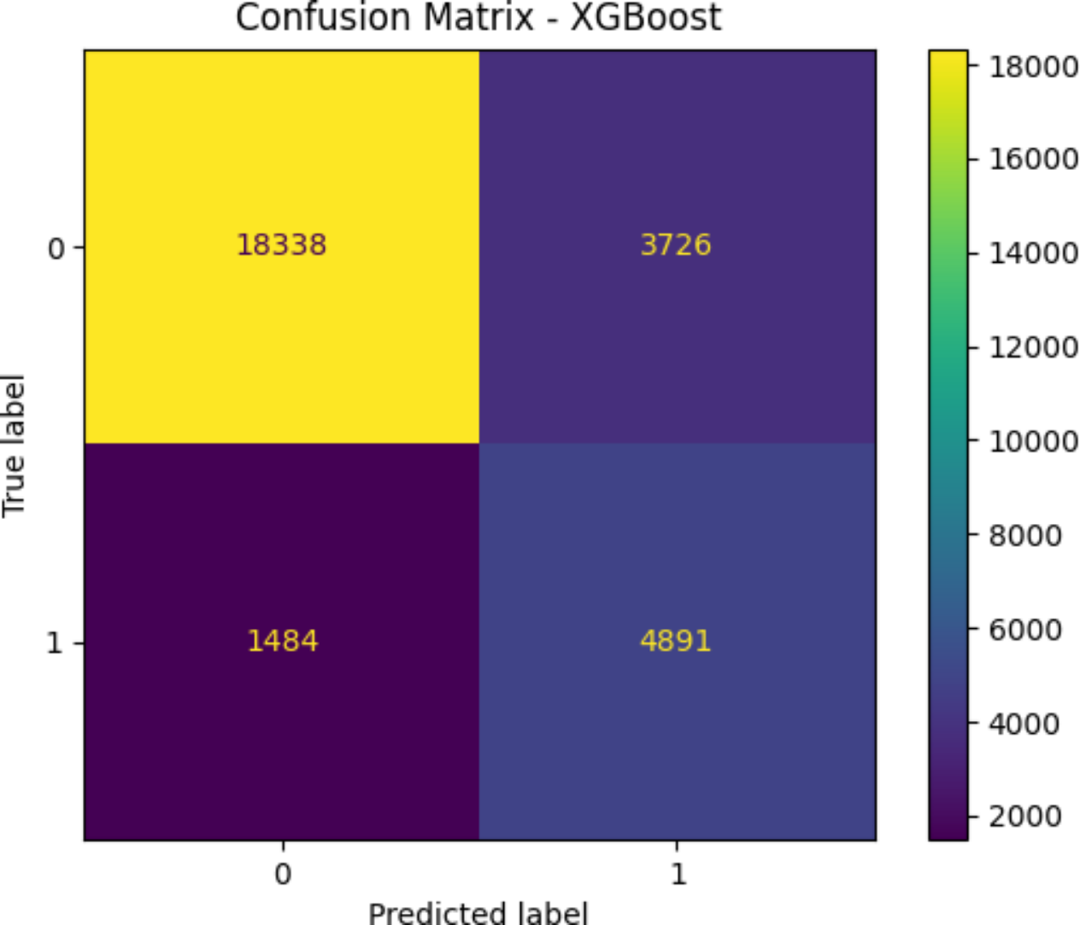
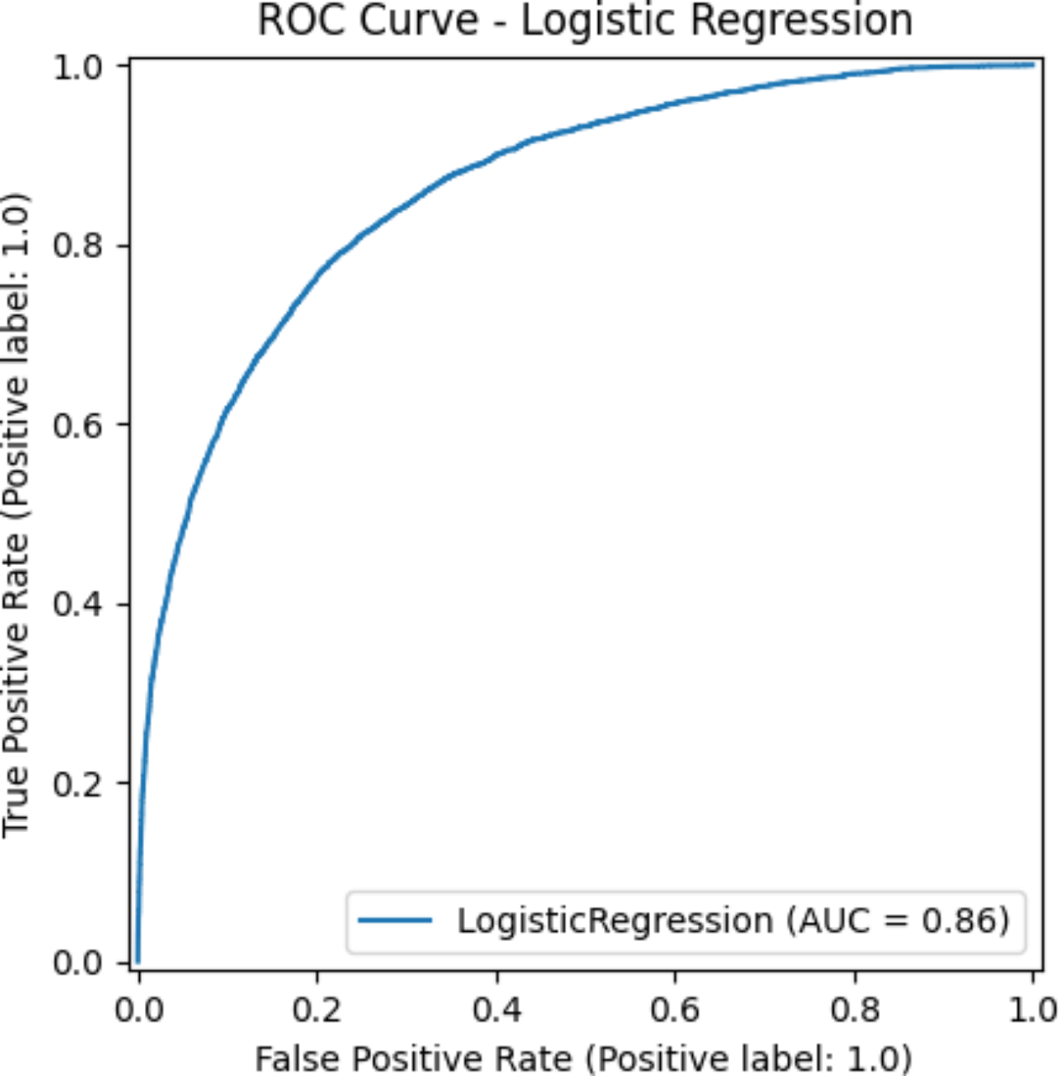
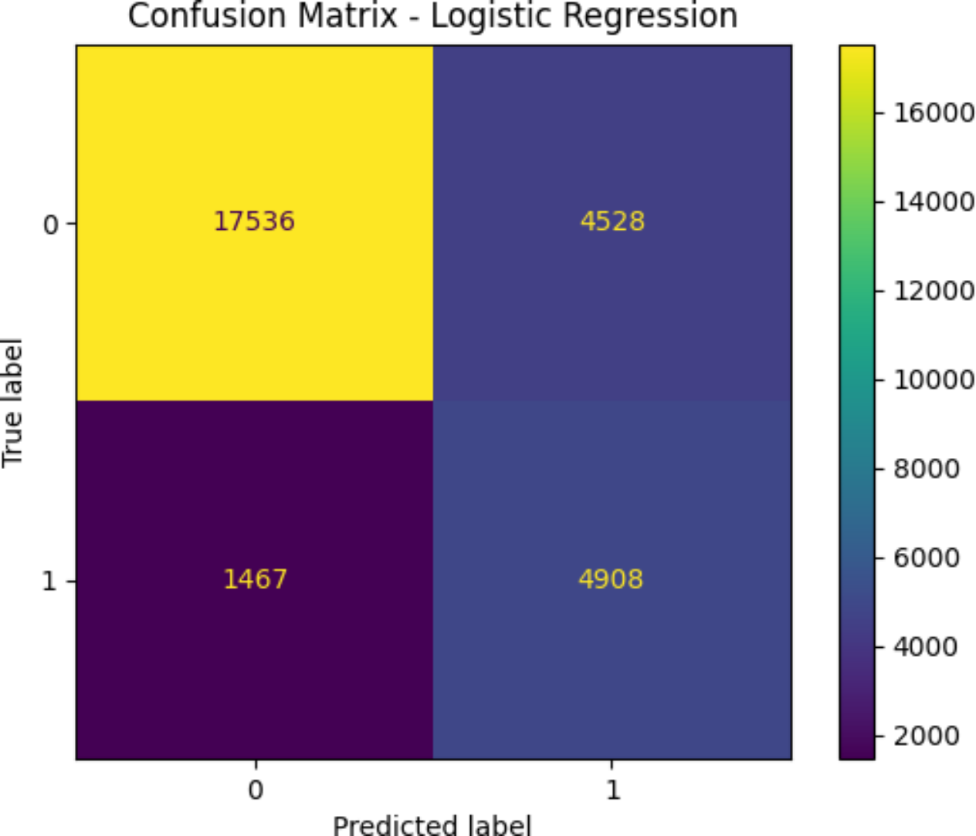
Model Performance
Table 1 summarizes performance. XGBoost led with AUC 0.89 and recall 0.77.
Model | Accuracy | Precision | Recall | F1 Score | ROC-AUC
Logistic Regression | 0.81 | 0.52 | 0.77 | 0.62 | 0.86
Random Forest | 0.84 | 0.78 | 0.47 | 0.59 | 0.88
XGBoost | 0.82 | 0.57 | 0.77 | 0.65 | 0.89
Neural Network | 0.80 | 0.51 | 0.62 | 0.56 | 0.85

Slide 16

Feature Importance
XGBoost identified Humidity3pm, TempDiff, and Location_Brisbane as key predictors.

Slide 17

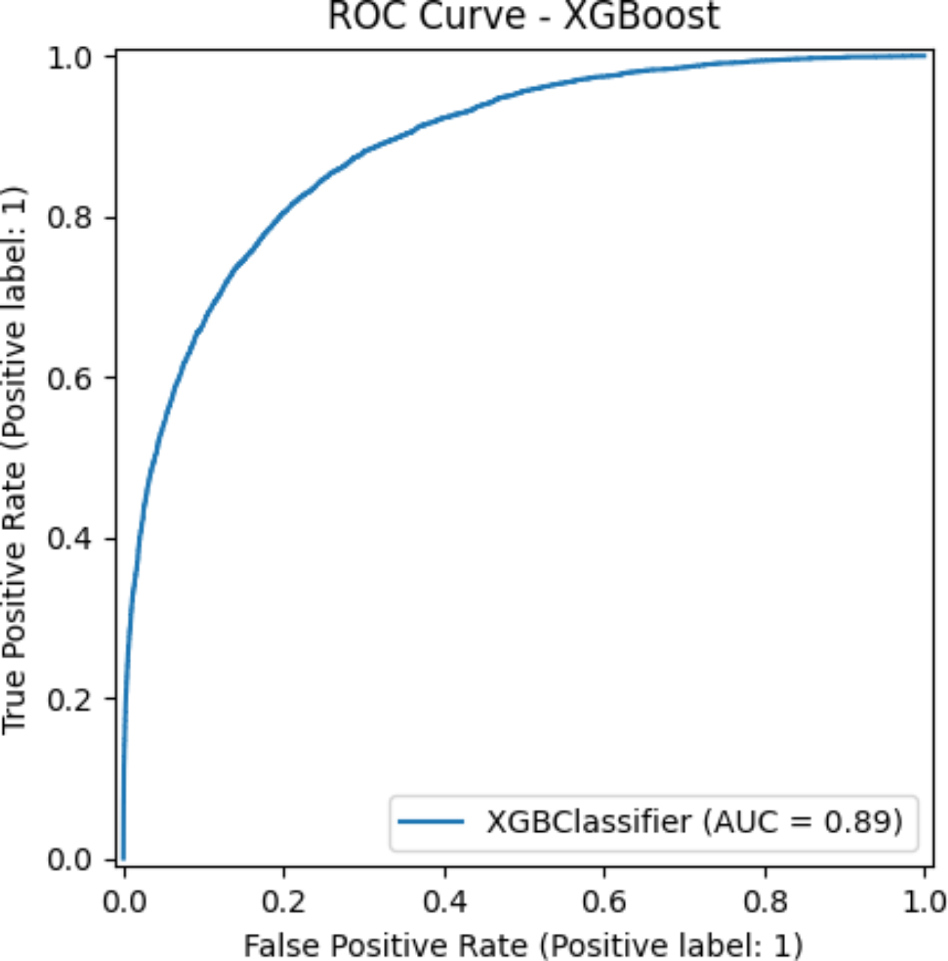
Discussion
2
The Australian dataset limits relevance to Pakistan.
XGBoost’s high recall (0.77) suits rainfall prediction, where false negatives are critical.
1
The Neural Network’s lower recall (0.62) may indicate overfitting.
3

Slide 18

06
Deployment

Slide 19

Deployment
The XGBoost model is deployed on Hugging Face as “Rainfall Predictor for Pakistan.”
Users input weather data to predict rain tomorrow.
Limitations include manual input and dataset mismatch.
Steps to use:
Visit the app link App.
Enter features (e.g., temperature, humidity).
Get a “Yes” or “No” prediction.

Slide 20

07
Conclusion and Future Work

Slide 21




Conclusion and Future Work
2
The Australian dataset’s mismatch is a key limitation.
XGBoost achieved the best performance (AUC 0.89, recall 0.77), deployed on Hugging Face.
1
Future work includes:
•Collecting Pakistan-specific data.
•Applying SMOTE for imbalance.
•Exploring ensemble stacking.
3

Slide 22

08
References

Slide 23


References
1
Kaggle. weatherAUS.csv dataset. Kaggle Dataset.
2
Scikit-learn. Scikit-learn.
3
XGBoost. XGBoost Documentation.
4
Keras. Keras Documentation.

Slide 24

Thank You

